Slide 1
Probe Point Analysis for Road Slope
Vincent Tran

Slide 2
Introduction
The first task is to match over 3.3 million probe points to one of over 200 thousand road links in partition 6467 in Germany
Bounding rectangle - 50.62500, 8.43751 and 53.43750, 11.25000
The second task is to find a derived slope for each road link using the probe data
The third task is to evaluate the derived slope and the surveyed slope data for each road link

Slide 3
Background
Mapping companies can map out roads by either:
Having surveying cars that drive over every road to collect data
Collecting probe data from people over time
It is much more efficient to use probing data because roads are constantly changing. It would be time consuming to hire someone to drive over every road every year in order to collect data
Probing data needs to be processed and matched to road links in order to be useful

Slide 4
Approach
Use geohash in order to find a list of candidate links that a probe point can belong to
This is way more efficient than trying to match each probe point to one of 200,089 road links
Match probe points to the link with the smallest perpendicular distance
To decide whether the probe point is traveling towards or away from a reference node:
Calculate the heading of the link
Compare it to the heading of the probe point

Slide 5
Approach
To find the derived slope of a link:
Find the closest probe point to the reference node
Find the closest probe point to the non-reference node
Calculate the slope from the difference in altitude and the distance between the two probe points
To evaluate derived slope and surveyed slope:
Find the surveyed altitude of the reference node
Find the surveyed altitude of the non-reference node
Calculate the slope from the difference in altitude and the distance between the nodes
Compare it with the derived slope

Slide 6
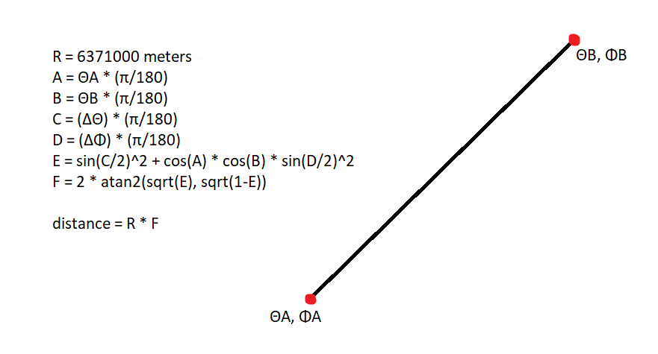
Approach
To find the distance between two lat/long coordinates:
Use Haversine formula

Slide 7
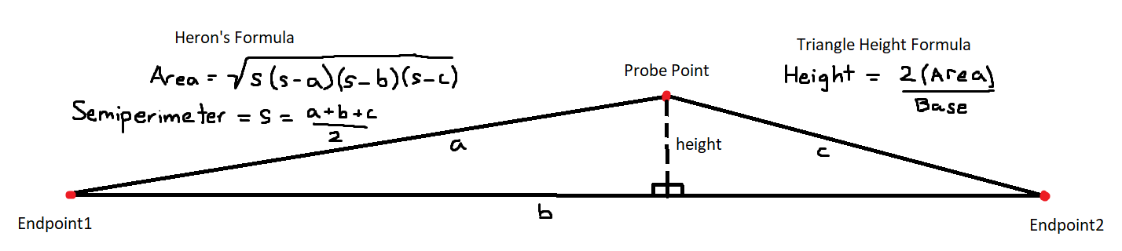
Approach
To find perpendicular distance from a probe point to a link:
Assume each road link is the base of a triangle.
The reference node and non-reference node are the two bottom vertices
Assume the probe point is the third vertex
Use Heron’s formula to find the area of the triangle
Calculate the height of the triangle

Slide 8
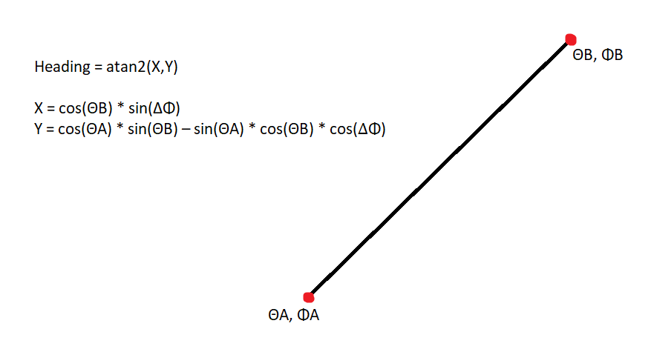
Approach
To find the heading of a link:

Slide 9
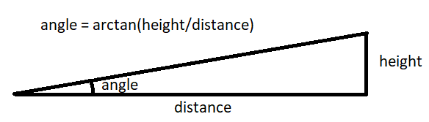
Approach
To find the slope of a link:
Use arctangent trigonometry to find the slope angle

Slide 10
Results
2,938,973 probe points were successfully matched to a link
Partition6467MatchedPoints.csv
149,581 links have enough probe points to calculate slope
Partition6467DerivedSlopes.csv
48,402 links have both surveyed 3D data and probe points to evaluate slope
Partition6467EvaluatedSlopes.csv

Slide 11
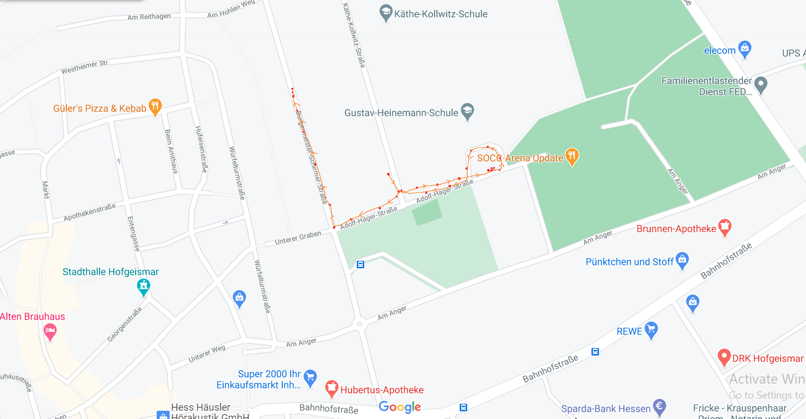
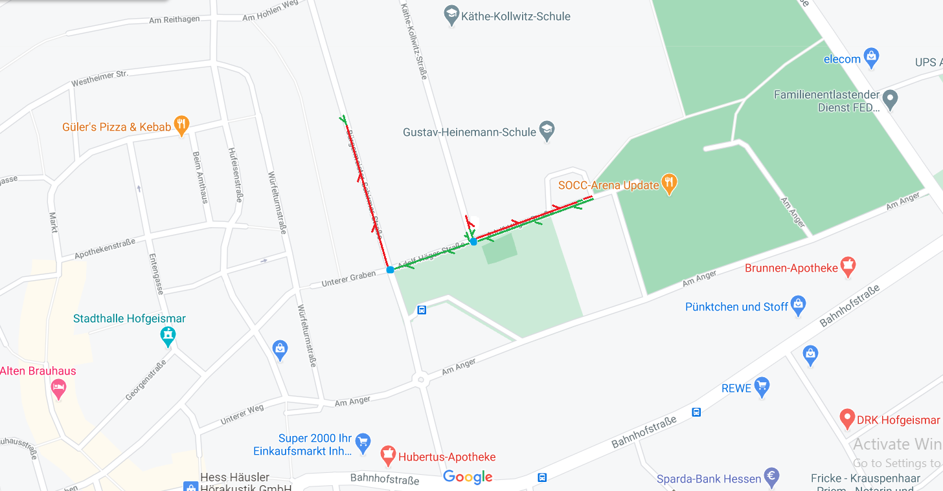
Results
This is one of the probe paths
Each probe point is a red dot
Each reference node is a blue dot
Red lines show the probe point moving away from a reference node
Green lines show the probe point moving towards a reference node
Probe Points
Matched Links

Slide 12
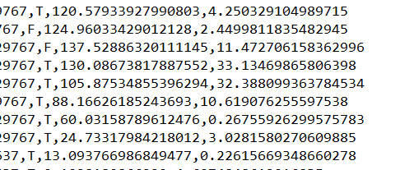
Results
Notice how there is no road link data for the loop that the probe point traveled
The algorithm matched the movement onto the nearest link
As a result, the perpendicular distance from the link is larger

Slide 13
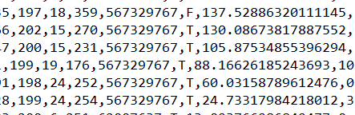
Results
MatchedPoints Data
The derived slope was calculated by using the difference in altitude and the distance between the closest and farthest probe points to the reference node
Altitude
Distance to reference node
DerivedSlopes Data
Slope angle

Slide 14
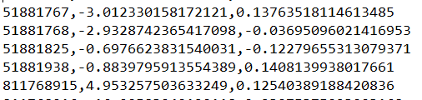
Results
The derived slope doesn’t compare well with the surveyed slope
There are some reasons why this might be:
There are not enough probe point data to calculate a precise slope
Probe points may be matched to the wrong links
The altitude measurement does not have enough significant figures to calculate a precise slope
EvaluatedSlopes Data
Derived slope
Surveyed slope

Slide 15
Conclusion
Geohashing allows probe points to efficiently locate candidate links
Probe data can help detect new roads that do not have links yet
Probe data can detect old roads that do not exist anymore
Probe data can help map altitude and road slopes for link data

Slide 16
References
Murphy, J., Pao, Y., & Yuen, A. (2019, November). Map matching when the map is wrong: Efficient on/off road vehicle tracking and map learning. In Proceedings of the 12th ACM SIGSPATIAL International Workshop on Computational Transportation Science (pp. 1-10).
Map images are captured from Google Maps

